Slide 1
Fund III Performance Review | Q2 2025
July 2025

Slide 2
Executive Summary
Asset Management Operational Review
Financial Overview
Valuations
Fund Forecast

Slide 3
Executive Summary | Key Areas to Monitor
Focus Area | Commentary
Sources & Uses | As of the end of Q2 2025, the fund has acquired $1,636M Total Cost of operating properties and land for development, the fund spent $52M on CapEx and development properties bringing the TC of the fund to $1,688M. The fund also spent $35M on other uses (origination fees, hedging costs, and financing the surplus of expenses over revenue). These uses were funded with $871M in equity contributions (out of a total $916M, including the MS JV) and $852M in debt, resulting in a current LTC of 49%.
Future Acquisitions | The Fund has around $500-600M of potential future acquisitions to complete, split across 4 buckets: Truist Refi: ~$100M additional deployment created by incremental proceeds from refi in Q4 Plymouth Sale: ~$90M additional deployment from potential sale of Memphis portfolio in Q4 Mapletree Co-Invest: ~$210M additional deployment from MT co-invest & refi in Q1 NOI Growth & One-Off Dispos: ~$190M additional deployment spread evenly from Q1 2026 through Q2 2027 On account of these initiatives, the Fund should open up $100M of deployment with aim to start closing deals in mid-September
Financing | As of quarter-end, the Fund is at 49% Loan-to-Cost. To align with the target LTC, the Fund is currently in due diligence for a $350M refinancing with Truist and U.S. Bank, secured by a pool of 46 properties. The proposed terms are an 8.0% debt yield and 65% LTV at SOFR + 1.90%. Upon closing, Fund LTC is expected to reach 53%. Additionally, the Fund is out to the market for a refi of the Mapletree portfolio. Given the high M2M of this portfolio, we will target an earnout loan to maximize proceeds over time Later in the year, the Fund will also seek a recast of the facility to extend the term through the fund life (past the current June 2027 expiration) and ensure covenant compliance after the Mapletree refi & co-invest. Considering the additional acquisitions of $500-600M, we will need to keep the flexible facility in place at the full size to support the deployment

Slide 4
Executive Summary | Key Areas to Monitor
Focus Area | Commentary
Downtime, Vacancies & Leasing Activity | 30 suites are currently vacant with a wtd avg downtime to date of 8 months as of Q2 2025 and an additional forecasted lease-up time of 7 months starting 7/1/2025 Fund 3 is projected to have an economic occupancy of 85.6% at year end 2025 per the 2Q25 Forecast 12 leases were signed in Q2 across 5 different markets, achieving 23% leasing spread over prior leases
Fund Performance | NOI at $17.9M for Q2 increased from $16.2M in Q1, mainly due to new acquisitions. YOC declined to 5.37%, compared to 5.52% in Q1 (Mainly due to the Acquisition Cap rate of the new properties). Same Store NOI (of ~$1,077M Total Cost of properties) decreased slight in Q2 from $15.6M to $15.5M, mainly due higher recoverable operating expenses incurred in the current quarter. As a result, the fund generated positive cash flow, FFO was $1.9M. After considering commitment fee adjustment and capex, Core FFO was ($4.8M). The fund is fully deployed as of quarter end, with one pipeline deal to be acquired before a reassessment on future acquisitions is completed.
Durability of Cashflows & Distributions | There will be no distribution in Q3 2025 due to the low cashflow and limited sources & uses until the refi will close We will reassess beginning distributions next quarter once cashflows stabilize after the refis are completed, the Mapletree co-invest is finalized, and the Plymouth sale is determined

Slide 5
Executive Summary | Key Areas to Monitor
Focus Area | Commentary
Development | As of Q2 2025, the Fund has commenced construction on 2 JV development projects, while 2 other development projects remain in the pre-construction phase with work due to start in Q3 2025. Construction is 70% complete based on total development costs excluding land purchase at Hazel Park. The construction loan for Joyce Kilmer closed at the end of June and the project broke ground early July. To date, we have called $31.9M of capital for the 3 JV projects New lease signed for ~25% of SF at Park 295 after the cutoff date in mid-July Development Financing: Park 295 and Swisher loans both secured with relationship banks in those markets (Pinnacle & Synovus) who were able to offer sub 300s spreads at >60% LTC Joyce Kilmer loan also secured with a relationship bank (BHI) with higher rate (375bps spread) offset by higher 65% leverage Lack of bank bids on Gibbstown due to location and small size of project forced debt fund loan with Berkeley at high spread (>500bps)

Slide 6
Executive Summary | Key Decisions
Future Acquisitions: On account of pending Truist refi (plus potential Plymouth sale & MT co-invest) initiatives, the Fund should open up $100M of deployment with aim to start closing deals in mid-September
Financing: Continue moving forward with MT refi efforts, aiming to secure earnout loan. Engage KeyBank in Q4 to discuss recast of existing facility
Distributions:
There will be no distribution in Q3 2025 due to the low cashflow and limited sources & uses until the refi will close
We will reassess beginning distributions next quarter once cashflows stabilize after the refis are completed, the Mapletree co-invest is finalized, and the Plymouth sale is determined

Slide 7
Executive Summary | Asset Management Operational Review
AM – highlighted section to be updated
Leasing Spreads:
12 leases were signed in Q2 across 5 different markets, achieving 23% leasing spread over prior leases
Since inception, the Fund has signed 104 leases with 41% spread over prior leases
Escalations:
Escalations in Fund III are consistently just above underwriting, this quarter was particularly high given an outsized escalation in Columbus
Q2 escalations were 5.66% against BP of 3.09%, while leases signed in last 12 months achieved 4.45% escalations vs 3.19% BP
Renewal Rate:
Renewal Rate for Fund III is trending at ~57% for the past 4 quarters
This rate trended slightly down this quarter, with 42% renewal rate in Q2 compared to 57% in last 12 months and 61% ITD
Downtime:
The Fund currently has 30 vacant spaces, 11 of which have extended downtime over 10 months
Vacant spaces are driven by a variety of factors including slow leasing activity, delinquencies, and delayed timelines due to construction. Several of the long-standing vacancies will be sale targets in the upcoming quarter.
Economic Occupancy:
Forecast Manager projects 85.6% economic occupancy for the Fund at year end, 2025

Slide 8
Executive Summary | Financial Overview
Open for update
Transaction Activity:
In Q2-25, the fund acquired 39 properties for a total cost of approximately $452M.
The fund anticipates one expected disposition for a sales price of $12M.
NOI & YOC:
NOI at $17.9M for Q2 increased from $16.2M in Q1, mainly due to new acquisitions. YOC declined to 5.37%, compared to 5.52% in Q1.
Yield on Cost is 5.37% with Development and 5.50% (excluding Development) for Q2, representing a decrease of 15bps from prior quarter mainly due to performance of assets acquired in 2025, specifically vacant properties.
The fund has called
Same Store NOI (of ~$1,077M Total Cost of properties) decreased slight in Q2 from $15.6M to $15.5M, mainly due higher recoverable operating expenses incurred in the current quarter.
FFO:
The Fund’s FFO is 1.2% for Q2, while Core FFO is 1.8% (adjusting for commitment fees). Theoretical Core FFO is 2.9% assuming 60% LTC and G&A of 0.5%.
Core AFFO was (3.1%) for Q2 after subtracting out $8.4M of capex and adding back $0.7M of financing costs amortization.

Slide 9
Executive Summary | Financial Overview
Ready for review
Financing & Leverage:
During the quarter, the fund was extend an accordion loan associated with the credit facility, we’ve drawn $40M of the $75M capacity of this Term Loan. The fund expects to repay this loan within 90 days, following the closing of the refinance with Truist Bank.
During the quarter, the fund closed and began drawing on two construction loans with a combined total capacity of $44.3M, outstanding balance as of quarter end is $9.6M.
The outstanding debt as of the end of Q2 was $852M, spread across $513M credit facility, $40M Term Loan B, $23M subline, $94.5M Apollo, $90M NYL, $81.5M BX, and $9.6M construction loan.
The Fund is working on a refi with Truist Bank for a pool of 47 properties expected to generate $350M in loan proceeds.

Slide 10
Executive Summary | Valuations, Development & Forecast
Updated from Finance
Valuations
FMV of Investments is $1,787M, increased from $1,318M, in Q2 driven by $452M Total Cost of Acquisitions, $8M of CapEx, $8M of Development costs and $.3M of net mark to market from appraisals.
Inception to date, the Fund acquired $1,650M of total cost. After completing $51M of cape, selling $15M of net proceeds, and creating $101M of value creation through appraisals, the Fund reached the current FMV of $1,787M.
Approximately 48% of the portfolio has been appraised (based on purchase price), accumulating $101.1M of unrealized fair value gains since inception.
Development
As of Q2 2025, the Fund has commenced construction on 2 JV development projects, while 2 other development projects remain in the pre-construction phase with work due to start in Q3 2025.
Construction is 70% complete based on total development costs excluding land purchase at Hazel Park. The construction loan for Joyce Kilmer closed at the end of June and the project broke ground early July.
To date, we have called $31.9M of capital for the 3 JV projects
Fund Forecast
Yield on Cost for the portfolio is expected to be 5.36% in 2025, growing to 6.73% by 2028
The total accumulated CapEx, TI & LCs for the seed portfolio is $144M through 2028
The seed portfolio achieves 17.7% Gross and 13.8% Net IRR assuming a 7-year hold period and a 5.83% exit cap

Slide 11
Fund ID | Fund III Overview
As of June 30th, 2025
Market Allocation by Purchase Price
1.9% | Columbus
1.0% | Cincinnati
5.0% | Memphis
5.3% | Jacksonville
0.9% | Tampa
4.8% | Charlotte
7.0% | Chicago
3.0% | Baltimore
5.2% | Philadelphia
13.4% | Dallas
Performance Metrics
Number of Buildings/Tenants | 183/384
Total Size (SF) | 12.8M
Total Cost⁽¹⁾ | $1,688M
Average Cost PSF | $132
Fair Market Value⁽²⁾ | $1,787M
Total Occupancy⁽³⁾ | 89.3%
Average WALT (Years) | 3.4
Run-Rate YOC⁽⁴⁾ (excl. Vac)/ Untrended YOC⁽⁵⁾ | 6.04%/7.61%
Loan-to-Total Cost⁽⁶⁾ | 49.1%
Loan-to-Value⁽⁶⁾ | 46.4%
Northern NJ | 23.7%
Long Island | 4.1%
Miami | 6.1%
Los Angeles | 4.9%
Atlanta | 13.8%
Secondary Value
Markets
Secondary Growth
Markets
Gateway Markets
Primary Value
Markets
Primary Growth Markets
Includes co-invest on 10-building NNJ portfolio.
According to quarterly valuations (still open for Q2 appraisal adjustment).
Represents physical occupancy based on SF occupied at end of quarter (and does not consider tenants with free rent/concessions as vacant).
Run-Rate YOC is calculated as Run-Rate NOI divided by Total Cost. Total Cost includes Purchase Price, Closing Costs, CapEx, TI & LCs. Run-Rate NOI is quarterly income annualized; less quarterly recoverable & non-recoverable expenses annualized. Quarterly income adjusts out one-time accounts such as Concessions, Prior Year Income, and Bad Debt. RR excl. Vac removes all properties with Physical Occupancy <80% as of 6/30/25.
Untrended Yield on Cost represents the NOI divided by the Total Cost if each suite were leased at the current assumed market rent today. Excludes leasing costs.
Loan-to-total cost and value do not include the impact of the subline balance. As of June 30, 2025.
Notes:
Add pie chart by FMV in addition to PP. Also show run-rate YOC

Slide 12
Executive Summary | Dry Powder Overview
We have ~$192M of forecasted AUM dry powder remaining (dependent on NOI growth) if we were to not continue with the Truist Refi, MapleTree Co-Invest nor the Plymouth sale
Future NOI Growth of the Fund allows $192M additional acquisitions
Total land, future construction costs, and development JV buyouts of $89M
Truist Refi results in $101M additional acquisitions
Total Acquisitions as of Q3 2025(excl. land) of $1,538M factoring in 51% co-invest with MS
MapleTree Co-Invest results in $210M additional acquisitions
Plymouth Sale results in $80M additional acquisitions
$1,558M Asset + Land Purchase Price acquired through Q3 ($1,629M before co-invest)
Notes:
Updateed Fund ID Dry Powder Overview with Pipeline

Slide 13









Financing Strategy & Summary
Simplified version
Key Takeaways
The Fund is expected to close on an $350M loan with Truist & US Bank for a pool of 46 properties in August 2025
Capital Call Line was paid down from $150M to $23M, we expect to terminate it in Q4 2025
Credit Facility increased from $247.5M to $553M, $75M of additional commitments secured to fund Mapletree Acquisition
 | Credit Facility | Term Loans
Lender
Interest Rate | SOFR | 4.10% | 4.00% | 4.63% | SOFR
Spread | 1.80%-1.85% | 2.05% | 2.30% | 1.90% | 1.90%
All-In Rate | N/A | 6.15% | 6.30% | 6.53% | SOFR + 1.90%
Effective Amount Hedged | $182M | $94.5M (100%) | $90M (100%) | $81.5M (100%) | $350M (100%)
Hedged All in Interest Rate | 5.61% | 6.15% | 6.30% | 6.53% | 5.50%
Loan Commitments | $605M | $94.5M | $90M | $81.5M | $350M
Effective Used Debt | $553M | $94.5M | $90M | $81.5M | $350M

Slide 14
Executive Summary | Financing Overview
AM to update
We have ~$275M of forecasted AUM dry powder remaining (after dispositions and dependent on NOI growth)
 | EOQ Balance | Commitments | All-In Hedged Rate | LTV/LTC
Credit Facility | $553M
Term Loan A | $175M | $175M
Term Loan B | $40M | $75M
Revolver | $338M | $355M
Permanent Loans | $266M | $266M
Apollo | $95M | $95M | 6.15%
New York Life | $90M | $90M | 6.30%
Blackstone | $82M | $82M | 6.53%
Truist (Closing) | - | $82M | 5.50%
Construction Loans | $9M
Pinnacle (Park 295) | $6M | $11M
BHI (Joyce Kilmer) | $3M | $6M
Berkeley (Gibbstown) | - | $6M
Synovus (250 Swisher) | - | $6M
~$1.3B Target Debt Size
($1.8B including facility re-syndication)
Target for $370M refi in 2025 and an additional refi in 2026
Notes:
Updateed Fund ID Dry Powder Overview with Pipeline

Slide 15
Asset Management Operational Review

Slide 16
Fund Occupancy

Slide 17
Contract Occupancy | Net Absorption – Fund 3
 | 2023 | 2024 | Q1 2025 | Q2 2025
Fund SF | 2,948,768 | 5,847,433 | 9,576,484 | 10,132,713
Beg Period Occupied SF | 2,633,521 | 5,387,339 | 8,765,453 | 9,465,229
Beg Period Occupancy | 89.3% | 92.1% | 91.5% | 93.4%
Lease Expiration | 49,700 | 367,901 | 63,990 | 206,746
Lease Commencement | 257,392 | 214,466 | 318,465 | 68,194
Net Absorption | 207,692 | -153,435 | 254,475 | -138,552
Disposition SF |  | 168,283 | 51,360
Occupied SF reduced due to Sale |  | 168,283 | 51,360
New Acquisition | 2,898,665 | 3,761,449 | 607,589 | 2,471,958
Vacant SF Acquired | 352,539 | 366,022 | 110,928 | 65,561
SF Adjustments |  |  |  | 65,229
End Period Occupied SF | 5,387,339 | 8,461,048 | 9,465,229 | 11,667,845
End Period Fund SF | 5,847,433 | 9,440,599 | 10,132,713 | 12,539,442
End Period Occupancy | 92.1% | 89.6% | 93.4% | 93.0%
Leases pending Yardi Terminations |  |  | 18,095 | 17,901
Adjusted Contract Occupancy |  |  | 93.2% | 92.9%
Negative net absorption for the quarter at ~(138.6K) SF
2.47M SF acquired in Q2 (Mapletree).
Audit of Mapletree vacancy/ onboarding underway and any corrections will be included in 3Q25
End of quarter contract occupancy is 93.0%
Adjusted occupancy for Xcision Medical 92.9%
SF Adjustment for 3001 Irwin (3pa00002) - was active in Yardi, but not acquired. Corrected and will be removed going forward.
Tenant Move-ins
Property | Tenant Move-In | SF | Rent PSF
1101 Venture Ct. (3tx00011) | March Products Inc. | 22,876 | 9.75
3338-3352 Democrat (3tn00001) | Koontz Electric Company, Inc. | 12,000 | 4.40
10755 Sanden Drive (3tx00014) | Circuit Works Corporation | 11,875 | 10.75
9176 Red Branch (3md00001) | Prime Egrocery Inc | 11,158 | 12.50
2160 Hills Avenue (3ga00001) | Champion Gymnastics & Cheer, LLC | 10,285 | 13.15
 |  | 68,194 | $9.95
Property | Q2 Tenant Move-Out | SF | Rent PSF | Move-out Reason
1460 N Glenville Drive (3tx00007) | Ericsson Inc. | 121,068 | 16.95 | Relocation for Business Contraction Within the Market
9 S. Forrest Avenue (3pa00001) | LCR Embedded Systems, Inc. | 29,620 | 10.50 | Relocation for Business Expansion Within the Market
801 Blacklawn Road (3ga00002) | Lake Park Logistics, LLC | 19,660 | 6.76 | Relocation for Business Expansion Within the Market
1801 S. GSW Parkway (3tx00002) | Melissa Cueller and Jeffrey Scott Crocoll | 18,095 | 7.84 | Mutual Agreement FP Opportunity
605-655 Hawaii Avenue (3ca00001) | SHLA Group, Inc. | 12,579 | 19.55 | Renovation or Redevelopment
605-655 Hawaii Avenue (3ca00001) | Cargo Planet Logistics | 5,724 | 18.42 | Renovation or Redevelopment
 |  | 206,746 | $14.46

Slide 18
Current Vacant Spaces | Property Level Leasing Updates – Fund 3
30 suites are currently vacant with a wtd avg downtime to date of 8 months as of Q2 2025 and an additional forecasted lease-up time of 7 months starting 7/1/2025
Additional vacancies may not be accounted for from the Mapletree acquisition. Being audited and will correct in 3Q25
Market | Property | Vacant SF | Suite Count | Asking Rent PSF | Annual Rent | Actual Downtime as of 2Q25 | 2Q25 Remining Downtime MLA | Forecasted DT | Leasing Updates
Northeast | 120-200 Adams Blvd | 128,096 | 2 | $14.71 | 1,883,898 | 11 | 4 | 15 | License agmt executed for 15K SF at $15 PSF until work is completed and lease is negotiated on 75K SF
Texas | 1460 N Glenville Drive | 121,068 | 1 | $11.00 | 1,331,748 | 3 | 12 | 15 | Property is currently under contract for sale
Northeast | 150 Rittenhouse Circle | 171,686 | 2 | $7.08 | 1,214,832 | 3 | 9 | 12 | Recent acquisition, make-ready underway, several tours
Texas | 1801 S. GSW Parkway | 106,580 | 4 | $6.25 | 666,125 | 24 | 6 | 30 | Make-ready underway-restarting leasing efforts in 2 weeks
Northeast | 23 Farinella Drive | 33,524 | 1 | $15.75 | 528,003 | 7 | 6 | 10 | Broker event being scheduled in early September. Make Ready work completed but for bathrooms
Florida | 4570 NW 128th Street | 39,515 | 1 | $12.75 | 503,816 | 12 | 6 | 15 | Still seeing limited leasing activity
Texas | 12621-12623 International Pkwy | 54,920 | 1 | $8.75 | 480,550 | 7 | 6 | 10 | Make-ready complete, activity starting to pick-up
Atlanta | 3285 Saturn Ct | 35,911 | 1 | $12.64 | 453,915 | 5 | 4 | 9 | Make-ready complete, activity is slow, likely need to change brokers this quarter
Texas | 2220 Chemsearch Blvd | 38,667 | 1 | $11.50 | 444,671 | 7 | 6 | 10 | Make-ready complete, activity starting to pick-up
Midwest | 4000-4024 Precision Dr | 75,000 | 1 | $5.24 | 393,000 | 18 | 6 | 21 | Property under contract for sale
Memphis | 4533 Old Lamar Ave | 112,422 | 1 | $3.25 | 365,372 | 10 | 9 | 19 | Make-ready complete, targeting sale
LA | 605-655 Hawaii Avenue | 18,303 | 2 | $18.00 | 329,454 | 1 | 9 | 6 | Make-ready work commenced; 1 suite pending TT vacating, 10-week construction timeline
Northeast | 9 S. Forrest Avenue | 29,620 | 1 | $10.00 | 296,200 | 1 | 9 | 10 | Completing make-ready, on the market
Atlanta | 801 Blacklawn Road | 19,660 | 1 | $7.50 | 147,450 | 1 | 6 | 7 | Make-ready completed, recent vacancy
Memphis | 4026-4080 Senator Street | 35,600 | 1 | $3.50 | 124,600 | 10 | 6 | 13 | Lost prospect because of sprinkler system, targeting sale
LA | 2260 S. Archibald Street | 6,184 | 1 | $16.00 | 98,944 | 2 | 4 | 6 | Limited leasing activity
Florida | 6200-6320 North Hiatus Road | 4,800 | 1 | $18.34 | 88,032 | 0 | 12 | 12 | Recent acquisition, leasing underway
Memphis | 4179-4189 Senator St | 16,500 | 3 | $5.00 | 82,500 | 10 | 9 | 16 | Limited leasing activity, targeting sale
LA | 1920 South Rochester Avenue | 5,843 | 1 | $13.20 | 77,128 | 2 | 9 | 11 | Limited leasing activity
Northeast | 7120 Ambassador Road | 6,541 | 1 | $11.50 | 75,222 | 31 | 9 | 34 | On the market for lease, limited activity
Northeast | 9176 Red Branch | 4,510 | 1 | $12.00 | 54,120 | 19 | 6 | 25 | Softly marketing the space for lease while negotiating the PSA
Memphis | 3338-3352 Democrat | 12,000 | 1 | $4.50 | 54,000 | 16 | 9 | 22 | No activity on the space, but the other 12K SF space was recently lease. Targeting sale.
Total |  | 1,076,950 | 30 | $9.00 | 9,693,578 | 8 | 7 | 14
Notes:
Ericsson : this building has 3 times the power we were aware of. They paid a termination fee of $2M and the team has a make ready plan and working on getting a bid out. > $1M

Slide 19
Top 10 Vacant Spaces | Property Level Leasing Updates Fund 2
Of the 10 major vacancies, four have been sitting for over 10 months. We are currently targeting a disposition for two of the 10 vacancies, 1460 N Glenville and 4000 Precision, both of which are under contract.
Property Address | Market | Vacancy SF | Actual Downtime as of Q2 | Market Leasing Assumption ($/SF) | 2Q25 Remining Downtime MLA | Notes
120-200 Adams Blvd | Northeast | 128,096 | 11 | $14.71 | 4 | Recently executed a license agreement on approx. 15K SF that should role into a 5 yr lease. One active prospect on the remaining 110K SF.
1460 N Glenville Drive | Texas | 121,068 | 3 | $11.00 | 12 | Building is in PSA negotiation.
150 Rittenhouse Circle | Northeast | 171,686 | 3 | $7.08 | 9 | Recent acquisition, make-ready underway, over 10 tours thus far.
1801 S. GSW Parkway | Texas | 106,580 | 24 | $6.25 | 6 | Make-ready underway-restarting leasing efforts in 2 weeks with new photos, etc.
23 Farinella Drive | Northeast | 33,524 | 7 | $15.75 | 6 | Broker event being scheduled in early September. Make Ready work completed for bathrooms. No tour activity.
4570 NW 128th Street | Florida | 39,515 | 12 | $12.75 | 6 | Increase in leads between mid-June and end of July to about 4 (mostly undisclosed). Only one toured.
12621-12623 International Pkwy | Texas | 54,920 | 7 | $8.75 | 6 | Make-ready complete, activity starting to pick-up
3285 Saturn Ct | Atlanta | 35,911 | 5 | $12.64 | 4 | Make-ready complete, activity is slow, likely need to change brokers this quarter. Leads and proposals are prior to May.
2220 Chemsearch Blvd | Texas | 38,667 | 7 | $11.50 | 6 | Make-ready complete, activity starting to pick-up
4000-4024 Precision Dr | Midwest | 75,000 | 18 | $5.24 | 6 | Property under contract for sale. Going hard August 11, closing September 2.

Slide 20
Economic Occupancy | 2025 Budget Forecast – Fund 3
Economic Occupancy methodology updated this quarter to align with Fund Finance and now uses NOI as defined by the ‘FPR P&L Account Tree’
Fund 3 is projected to have an economic occupancy of 85.6% at year end 2025 per the 2Q25 Forecast;
Vacant spaces, Terminations and 2025 Rollovers are closely monitored and modeled in the forecast
The 2Q25 Forecast includes updated the Mapletree acquisition
Please note: Aligned Economic Occupancy methodology takes Concessions + Vacancy over NOI + Concessions + Vacancy.
Net Operating Income is per the FPR P&L account tree which has legal costs, marketing etc. below NOI, previously included in non-recoverable expenses
Description | EOQ 9/2025 | EOQ 12/2025 | EOQ 3/2026 | EOQ 6/2026
Economic Occupancy | 87.2% | 85.6% | 88.5% | 89.5%
 | 28,371,215 | 28,835,433 | 29,261,707 | 29,771,623
Base Rent | 409,417 | 988,722 | 1,048,018 | 907,479
Less - Concessions | (3,078,141) | (3,027,101) | (2,211,128) | (2,146,692)
Less – Vacancy | 87.2% | 85.6% | 88.5% | 89.5%
Net Operating Income | 23,849,930 | 23,888,963 | 25,082,097 | 25,925,531

Slide 21
Markup to Market Projection – Based on July 2025 11 Yr CFs
12.3% mark-to-market as of today at 100% Economic Occupancy.
Market Rent Growth used in the current Forecast Manager book is conservative compared to previous books. The 5 Yr CAGR is 4.1%, slightly higher than Fund 2 given market composition.
Fund 3 M2M Potential as of today is 23% and excluding non-industrial tenants is 35%
At 100% occupancy, the M2M potential is 7.7%. This assumes 9% of the current vacancy is leased up at market rate, pushing the YOC to 7%+
Link Portfolio, 1425 Grandview and 920 NW 159 Dr (Krsipy Kreme) are above market rate and
 | Fund 3 (2Q) | 2025 | 2026 | 2027 | 2028 | 2029 | 2030 | 2031 | 2032 | 2033 | 2034 | 2025-2029 CAGR
A | Market Rent | $9.65 | 10.09 | 10.48 | 10.92 | 11.35 | 11.8 | 12.28 | 12.77 | 13.28 | 13.82 | 4.1%
B | In-place Rent @ 100% Economic Occupancy | $8.59 | 9.21 | 9.73 | 10.54 | 11.19 | 11.8 | 12.36 | 12.97 | 13.53 | 13.96 | 6.8%
C | In-place Rent @ 89.0% Economic Occupancy | $7.88
A/B | M2M at 100% Economic Occupancy | 12.3% | 9.6% | 7.7% | 3.6% | 1.4% | 0.0% | -0.6% | -1.5% | -1.8% | -1.0%
A/C | M2M As-Is | 22.5%
B/PP | In-place Cap Rate @ 100% Occ | 6.6%
A/PP | Untrended Cap Rate | 7.6% | 7.9% | 8.2% | 8.6% | 8.9% | 9.3% | 9.6% | 10.0% | 10.4% | 10.9%
C/TC | RR YOC | 6.1%
A/TC | Market Rent YOC | 7.4% | 7.5% | 7.5% | 7.6% | 7.7% | 7.8% | 8.0% | 8.1% | 8.3% | 8.5% | 0.9%
ID | Assets | SF | Purchase Price | Total Cost 2Q25 | WALT
Fund 3 | 176 | 12,848,819 | 1,636,512,633 | $1,675,057,573 | 3.4
Notes:
Exit cap Calculator Notes
Right now the Fund 2 and Fund 3 model use approx. the same exit cap. This is based on the the wtd avg baseline cap rate by market and its allocation and a 5% portfolio premium which gets us to 5.77%
The exit cap calculator is a function of the remaining WALT and M2M and adjusts the exit cap. It uses a 7.5% Fund level M2M and adjusts the exit cap for each deal based on the M2M of the deal.
If a fund has a higher M2M, the exit cap will be lower. So, by that logic, Fund 2 should have a lower exit cap.
However, the research team is verifying the baseline exit cap as well as the 2024 MRG which is expected to come in higher than Q1-24 LMS 2024 MRG.
If we use a 4% Fund level M2M for Fund 3, this benefits acquisitions, because most deals will have a higher M2M than the 4% and by normalizing to the 4%, they will end up with a lower exit cap and allow for more aggressive underwriting.
In short, the M2M validates the 7.5% Fund level assumption.

Slide 22
Leasing Spreads & Downtime

Slide 23
Q2 2025 | Signed Leases – Fund 3
KEY HIGHLIGHTS
2 New Leases and 10 Renewals/Expansions signed in Q2-2025, in addition, 3 short term leases under 12 months were signed.
Name | Market | Activity Type | Tenant Name | Term (Years) | SF | PSF | PSF (BP) | FM PSF | Rexy | Escalations | R&D Escalations | Total Lease Value | Downtime | CTV | Credit Score | AML
1100 Shallowford Road | Atlanta | Renew | Pacesetter Steel Service, Inc. | 5.0 | 101,334 | $9.25 | $8.54 | $9.00 | $8.04 | 3.50% | 3.92% | $4,635,881 | 0 | 14% | 3 | Pass
2098 Integrity Drive N | Columbus | Renew | Ohio Department of Administrative Services | 2. 0 | 40,800 | $10.10 | $5.78 | $7.00 | $6.75 | 18.81% | 3.50% | $901,680 | 0 | 8% | Not Completed | Pass
2098 Integrity Drive N | Columbus | Renew | Ohio Department of Job and Family Services | 2. 0 | 39,200 | $9.60 | $5.78 | $6.50 | $6.75 | 19.79% | 3.50% | $827,120 | 0 | 8% | Not Completed | Pass
3338 Democrat Road | Memphis | New | Koontz Electric | 1.6 | 12,000 | $4.25 | $4.67 | $4.50 | $5.40 | 3.50% | 3.50% | $81,791 | 18 | 6% | 6 | Pass
3338 Democrat Road | Memphis | Renew | American Builders & Contractor Supply Co., Inc. | 3. 0 | 12,000 | $4.95 | $4.33 | $3.95 | $5.40 | 10.10% | 3.50% | $196,200 | 0 | 4% | Not Completed | Pass
3298 Democrat Road | Memphis | Renew | American Builders & Contractor Supply Co., Inc. | 3. 0 | 34,200 | $4.95 | $4.02 | $4.75 | $5.01 | 10.10% | 3.50% | $559,170 | 0 | 6% | Not Completed | Pass
3696 Knight Road | Memphis | Renew | USCutter Inc. | 5. 0 | 48,534 | $4.70 | $3.76 | $4.50 | $4.46 | 3.25% | 3.50% | $1,198,126 | 0 | 3% | 4 | Pass
5465 E. Raines Rd | Memphis | Renew | Dematic Corp. | 3.0 | 120,000 | $4.25 | $4.10 | $4.00 | $4.91 | 3.50% | 3.50% | $1,584,180 | 0 | 4% | Not Completed | Pass
3755 Knight Arnold Road | Memphis | Renew | Aluma-Form, Inc. | 5. 2 | 211,650 | $3.15 | $3.25 | $3.15 | $3.90 | 3.25% | 3.50% | $3,576,595 | 0 | 13% | 5 | Pass
4133-4175 Senator St | Memphis | Renew | All-N-Express, LLC | 3.0 | 3,450 | $5.75 | $5.10 | $5.00 | $6.90 | 3.00% | 3.50% | $61,315 | 0 | 4% | N/A-Deal under $100K Total Rent | Pass
3140 Route 22 | Northern NJ/New York | Renew | Marcolin U.S.A. Eyewear Corp. | 10. 0 | 151,000 | $12.50 | $15.68 | $12.49 | $15.75 | 4.00% | 3.43% | $22,661,521 | 0 | 21% | 5.5 | Pass
155 Pierce Street | Northern NJ/New York | New | Digi America | 5.2 | 9,292 | $17.00 | $17.45 | $15.75 | $20.09 | 3.50% | 3.43% | $852,017 | 6 | 11% | 5 | Pass
Total/WA |  |  |  | 5. 2 | 783,460 | $6.99 | $7.00 | $6.55 | $7.50 | 5.51% | 3.54% | $36,135,600 | 12.7 | 12%
DEAL NOTES
Ohio Department (2), Chicago - Renewal with State of Ohio who only does a gross lease structure with 2 years term- net equivalent rent would be $8.60 PSF in year 1 and $10.50 in year 2
American Builders & Contractors (2), Memphis- Multiple requests were made to review financials but were denied
Notes:
DEAL NOTES
Genband, Chicago - Updated the SF to 8,613 per MeasureUp drawings to capitalize on increase SF. This space has been historically on a MG lease. The new NNN lease will improve recovery composition at this location. Taxes are $4.20 at this property. It is about $2 more than DuPage County. The Rexy rate would be comparable to the general market, discounting for the higher tax number.
Centerpoint Marketing, Chicago - Tenant is downsizing and renewing at 1 out of 2 units they occupy. We will be able to capitalize on renting the leftover 20k SF at a premium. The tenant has good payment history, and the space shows well for tours. We have increased their SD, despite of them downsizing, based on credit score.
Magic Screenprint, Atlanta - Existing tenant vacated. Converted the 2 sub-tenants to a New Lease. This deal is at higher than UW base rate, no downtime, no TIA, no abatement.

Slide 24
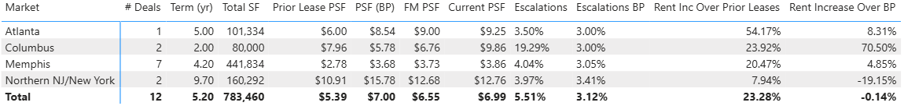
Q2 2025 | Market Level Summary – Fund 3
Fund 3 achieved a 23% leasing spread in Q2 and was in line with business plan expectations. Escalations averaged 5.51%, about 240 bps above original business plan, but including one unusually high escalation in Columbus.
1. Deals represent executed leases with term > 12 months​
2. Rent Increase over Prior Lease calculation excludes spaces that were previously vacant​

Slide 25
Downtime Quarterly Trend | Fund 3
Fund 3 downtime is exceeding UW DT as of Q2-2025 due to a drag created by long standing vacancies.
* ”Months to lease” – pulled from CoStar (7/25/25) for industrial properties 20-200KSF in FP markets

Slide 26
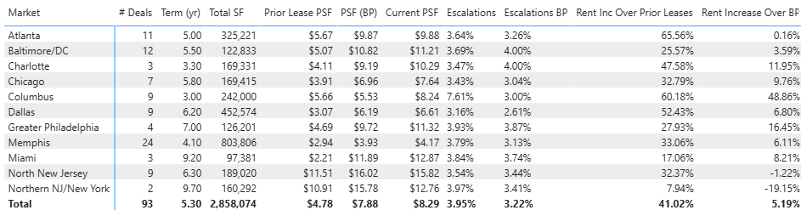
Leasing Performance since Inception | Fund 3 Stats
Fund 3 leasing spreads at 23% are in line with the portfolio at 29%, though it has slightly moderated from it’s year one levels of 43%.
Renewal Rate was above the historical average in Q2 at 83%. Over the last year it has been 57%.
Fund 3 escalations continue to be very ahead of BP, with Q2 superseding business plan by about 240 bps and since inception exceeding business plan by 75 bps.
1. Deals represent executed leases with term > 12 months​
2. Rent Increase over Prior Lease calculation excludes spaces that were previously vacant​

Slide 27
Quarterly Trend | Fund 3 Leasing Spreads Achieved
Fund three outperformed forecast manager in Q2 and was in line with business plan.
Fund 3 achieved strong 2Q25 leasing spreads, which was anticipated in the original underwriting, over prior lease of 23% in 2Q25

Slide 28
Q2 2025 | External benchmarking
Lease escalations based on FP lease table; other metrics pulled from CoStar (7/25/25) for industrial properties 20-200KSF in FP markets

Slide 29
Portfolio Trends

Slide 30
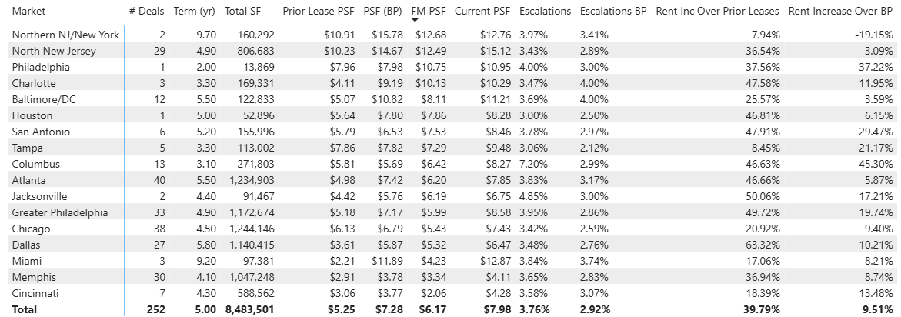
Leasing Performance since Inception | Overall Portfolio Stats (Fund 2 & 3)
252 Leases signed since inception with a Wtd. Avg. Rate of $7.28 and Wtd Avg. Term of 5.0
Leasing Activity achieved a spread of 40% over prior leases and 10% over Business Plan
New Leases achieved a higher rate spread over Business compared to Renewals. However, when adjusted for below market fixed option renewals, Rexy comparisons disprove a renewal bias.

Slide 31
Quarterly Trend | Portfolio Leasing Spreads Achieved (Fund 2 & 3)
Faropoint leasing activity to date has achieved an average ~40% spread over prior lease rates, and ~10% spread over Business Plan.

Slide 32
Portfolio Downtime since Inception | How is actual Downtime trending?
74% of signed new leases since inception in both funds have a downtime < 6 months.
~22% of signed new leases since inception exceeded UW downtime.
28% of the leases that exceeded UW downtime occurred in the past year.
The data set represents ~132 new leases signed since inception.

Slide 33
Tenants Lost | Impact on Renewal Rate (Fund 2 & Fund 3)
The past quarter saw a total of 17 tenant move-outs, of which 11 were in Fund 2, across markets, varying in size ranges.
One of the move outs was a result of a business closure/financial difficulty and one was the result of an eviction, both in Fund 2

Slide 34
AR (Operational Overview)

Slide 35
Fund 3 | Tenant AR Summary
How are the tenants from Q4 trending?
Level 3 tenants balance from 1Q25 reduced due to Xcision Medical (MD) being moved to Level 4 will all other Level 3 tenants having growing balances and 3 new tenants identified this quarter.
Level 4 tenants: Blackbeard Marine’s (TX) $256K balance from 1Q25 has been written off which was offset by Xcision Medical (MD) being added back to Level 4 with a 60+ balance of $145K.
Level | Description
0 | No Balance
1 | Administrative
2 | Disputes
3 | Payment Plans/Watchlist
4 | Eviction / Past Tenant
New Activity emerging in Q2
3 new Level 4 default pool
Xcision Medical in Baltimore- prior Level 3, did not pay again in 2Q25 and was upgraded to a Level 4 tenant. $145K 60+ Balance
Thieme Gmbh & Co. KG. in Chicago- Termination Agreement pending and tenant is vacating 8/31/2025. Natural LXD 12/31/2028; $0 60+ balance
Lauxes Grades Corp. in LA- Truist Refi TT- TT vacated in early July; Termination Agreement pending and Natural LXD 3/31/2026; $0 60+ balance
3 new tenant added to the Level 3 payment plan pool
Sannova Analytical in NJ- TT in default but communicating they will pay. Escrow in place for potential default; $42K 60+ balance
Krispy Kreme in Florida- Blackstone TT-TT has experienced extreme volatility in the stock market and has been added to the watchlist; $0 60+ balance
Club & Cycle in Baltimore- Retail TT has communicated operational struggles and inability to pay; $1.9K 60+ balance

Slide 36
Fund 3 | Level 3 Tenants
Status​ | Property​ | Tenant​ | Credit Score | Area | In-Place Rent​ | Q1 25 Risk​ | Q2 24 Risk​ | 0-60 Days Balance​ | 60+ Days Balance​ | Notes​
Current | 9176 Red Branch (3md00001) | Xcision Medical Systems, LLC (t0000841) | 3 | 17,901 | $10.09 | 3 | NEW 4 | $36,290 | $145,948 | TT previously evicted but was able to make a large payment in 1Q25; property pending sale
Past​ | 1801 S. GSW Parkway (3tx00002) | Melissa Cueller and Jeffrey Scott Crocoll, dba MT Training Center (t0000948) | n/a | 18,095 | $7.54 | 4 | 4 | $0 | $108,905 | Termination agreement fully executed effective 1/7/2025. Tenant did not submit payments per agreement and AMs filed lawsuit to attempt to collect. Lawsuit ongoing
Current | 9 S. Forrest Avenue (3pa00001) | LCR Embedded Systems, Inc. (t0000847) | n/a | 29,620 | $10.50 | n/a | 4 | $14,864 | $25,328 | TT moved out at natural expiration 5/31/25; moveout accounting pending and additional restoration charges forthcoming
Current | 3605 Swenson Ave (3il00010) | Thieme Gmbh & Co. KG (t0001376) | n/a | 28,800 | $6.03 | n/a | New 4 | $2,597 | $0 | Termination Agreement pending and tenant is vacating 8/31/2025. Natural expiration 12/31/2028
Current | 2260 S. Archibald Street (3ca00003) | Lauxes Grates Corp. (t0001474) | n/a | 6,725 | $21.70 | n/a | New 4 | $1,542 | $0 | Truist Refi TT- TT vacated early July. Termination agreement pending and balance will likely be paid through security deposit. Natural Expiration 3/31/2026
Past​ | Multiple​ | Multiple (3 Tenants) ​ |  | ​ | ​ | 4​ | 4​ | $277 | $9,839 | All tenants have moved out. Most of the balance is anticipated to be collected

Slide 37
Fund 3 | Level 3 Tenants
Status​ | Property​ | Tenant​ | Credit Score | Area | In-Place Rent​ | Q1 25 Risk​ | Q2 24 Risk​ | 0-60 Days Balance​ | 60+ Days Balance​ | Notes​
Active | 155 Pierce Street (3nj00028) | Sannova Analytical Inc (t0001423) | 3 | 21,000 | $15.46 | n/a | NEW 3 | $85,032 | $42,516 | TT in default and LL filing for judement of eviction; LL working with TT to restructure lease for more favorable term in which case balance to be written off. If evicted, LL will be reimbursed from escrow
Active | 4105 S Mendenhall Road (3tn00010) | KPower Global Logistics, LLC (t0001277) | 4 | 102,500 | $3.34 | 3 | 3 | $46,881 | $32,126 | Tenant filed for bankruptcy. Headquarters location and June rent received but being held under direction of counsel. Lease assignment anticipated
Active | 13001 NW 38th Ave (3fl00009) | Gemcap Investments, LLC (t0001169) | 4.5 | 27,000 | $12.71 | 3 | 3 | $0 | $27,520 | Tenant softness identified and is honoring payment plan and catching up on outstanding chages. Collection anticipated
Active | 14735 NW 25th Court (3fl00001) | Caricom Freight Consolidators, Inc. (t0000782) |  | 25,327 | $10.76 | 3 | 3 | $14,822 | $20,660 | Tenant honoring payment plan and catching up on outstanding charges. Collection anticipated
Active | 12900 NW 38th Ave (3fl00010) | BES Associates, Corp. (t0001165) | 5.5 | 25,050 | $12.59 | 3 | 3 | $4,880 | $10,845 | Blackstone TT- Tenant Softness Identified; TT Paying Monthly and collection on past due late fees not anticipated. Potential lien on property due to outdoor storage violations with TT physically cleared but payment outstanding. AM researching.
Active | 7120 Ambassador Road (3md00004) | Club & Cycle, LLC (t0000990) |  | 4,342 | $10.92 | n/a | NEW 3 | $8,091 | $1,851 | Tenant softness identified and TT communicated operational struggles and an inability to pay rent in timely manner. AM working on payment plan is marketing suite
Active | 920 NW 159 Drive (3fl00005) | Krispy Kreme Donut Corporation (t0001163) | 5 | 32,082 | $15.53 | n/a | NEW 3 | $25,092 | $0 | Blackstone TT- Outstanding charges are CAM related. New Level 3 (2Q25) due to recent sharp decline of stock price (-68%) since beginning of year (as of 7/8/25)
Active | 800-812 Greenleaf Avenue (3il00007) | Krishiv Foods, LLC (t0000970) |  | 9,250 | $9.31 | 3 | 3 | $11,466 | $0 | Tenant softness identified and last payment received in May. TT previously placed under default and became current. AM restarting default process.
Active | 3276 Democrat (3tn00003) | Lanter Distributing, LLC (t0000899) |  | 45,000 | $3.63 | 3 | 3 | $2,147 | $0 | TT current but for late fees. LL has judgement to evict TT at any time due to nonpayment and is being monitored. Collection anticipated
Active | 70-82 McKee Drive (3nj00019) | Six Thirteen Originals, LLC (t0001112) | 6.0 (Light) | 63,261 | $12.00 | 3 | n/a | $0 | $0 | NYL Tenant- As of the date of the reports TT was current but the July payment has since been returned. $55K Total balance due

Slide 38
AR Monitoring | Loan Pools
The Apollo Loan has no tenants currently being monitored.
(2) Tenants with open balances are CAM related and are not being disputed
Biazzo Dairy, 1145 Edgewater, NNJ
Level 1
CAM related and AM anticipates collection
Thomas Scientific, 1654 High Hill Road, NNJ
Level 1
CAM related and AM anticipates collection
Prior issue with Blackbeard Marine, 2200 Chemsearch, Texas has been written off and closed out
Prior issue with Gorilla Rides, 4390 Westroads, Florida has been cleared with an approved sublease and TT is now current
The Blackstone Loan has 2 tenants that are being monitored
Krispy Kreme , 920 NW 159 Drive, Florida
Level 3
Watchlist tenant with no major balance issue as of Q2 25 but has experienced extreme stock price volatility and is being monitored
BES Associates, 12900 NW 38th Ave, Florida
Level 3
Watchlist tenant with ~$11K 60+ day balance comprised of predominately late fees and collection is not anticipated.
Prior issue with Vision Technologies, 6704 Curtis, Baltimore CAM dispute has been resolved and pending correction
The New York Life Loan has 1 tenant that is being monitored
Six Thirteen Originals, 70-82 McKee Drive, Northern NJ
Level 3
As of the date of the reports, TT had paid but payment returned as NSF and as of 7/17/25 TT has a $50K balance. Figures below revised to include information as of 7/17/25.
Lender | Property | Market | Lease | Area (SF) | Q2 25 Tenant Risk | 0-60 Owed | 60+ Owed | Total Owed
New York Life | 70-82 McKee Drive (3nj00019) | Northern NJ | Six Thirteen Originals, LLC (t0001112) | 63,261 | 3 | $5,131 | $50,306 | $55,437
Blackstone | 12900 NW 38th Ave (3fl00010) | Florida | BES Associates, Corp. (t0001165) | 25,050 | 3 | $4,880 | $10,845 | $15,724
Blackstone | 920 NW 159 Drive (3fl00005) | Florida | Krispy Kreme Donut Corporation (t0001163) | 32,082 | 3 | $25,092 | - | $25,092

Slide 39
Financial Overview

Slide 40
Balance Sheet
Key Takeaways
Operating Properties:
In Q2-25, the fund acquired 39 new properties - including the Maple Tree portfolio ($328M) - for approximately $452M in total. Total cost at acquisition is $1,636M.
FMV as of Q2-25 is $1,787 (TC of $1,688) – represents 6% of unrealized appreciation.
Approximately 48% of the portfolio has been appraised, accumulating $100M of unrealized fair value gains since inception.
Development Portfolio:
increase of $8.2M of development capitalized costs, mainly related to Hazel Park.
Cash:
Cash balances are currently earning 3.0% (ICS) and 3.2% (JPM). The Q2-25 ending cash balance increased due to several timing-related items:
A $2.8M Joyce Kilmer loan received late in the quarter, not yet disbursed
A $1.5M TI reimbursement from the NWBC JV
Temporary transfer delays due to a new dual-authorization protocol, now resolved
A $785K escrow release pending
Target cash levels expected to stabilize near $12M
Derivative Instruments:
The Fund is 91% hedged. The decline in FMV reflects changes in SOFR forward curve.
Loans
The credit facility balance increased in Q2 with $252M drawn for the Maple Tree portfolio and a new $40M Term Loan B. The subline balance stands at $23M, following a capital call, and the subline commitment was reduced to $50M.
The Fund drew $9.6M on two construction loans during the quarter, with two additional development loans expected to close in Q3 2025.
WA LTC was 46% excluding the subline and development loans, 56% including them.
Equity
As of 6/25 the total contributions reached $839M, up $274M from PQ, representing 95% of the Fund’s commitments (excluding non-controlling interest commitments).
Gross TVPI = 1.11x (1.16x Q1); Net TVPI = 1.07X (1.10x Q1)
Gross IRR = 12.1% (14.1% Q1); Net IRR = 7.0% (8.3% Q1) – Larger spread is due to mgmt. fees being charged on full commitment prior to calling the full capital.
1
1
2
3
2
4
3
5
4
5
6
6
Notes:
Add comment on the 50m on the subline - excess cash elaborate more, includes escrows , long term analysis is at 12- loan draw down and the technical issue dual approval -

Slide 41
Income Statement
Key Takeaways
NOI:
There was a $1.6M increase in NOI (5.37% YoC) from PQ mainly due to fund being in the investment period.
Change in Fair Value of Investment Property:
In Q2-25, 24 properties were appraised, including 4 that were valued for the first time, resulting in $4.1M of MTM gain. This gain was offset by $3.8M of closing costs written off through change in fair value of investment property.
The overall increase in the FMV appraisals was 0.7% compared to the last appraisal value/PP.
Interest Rate:
The EIR, which includes unused fees, financing cost amortization, and cap amortization, was 6.23% excluding subline and development in Q2-25 decreased from Q1-25 by 36 bps due to hedge gains in the quarter from the 4 newly entered hedges in the period.
Base interest excluding subline and development is 5.57%, decreasing from PQ by 25 bps due to hedge gains in the quarter from the 4 newly entered hedges in the period.
1
2
1
3
2
3
Notes:
Corrected

Slide 42
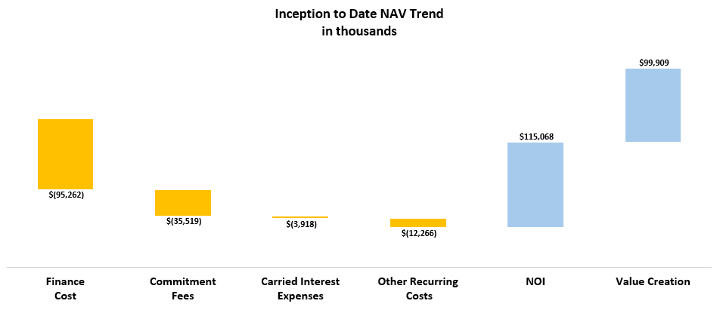
Inception to Date Gain Breakdown – NAV Trend
Outstanding Equity
$936,626
Equity Called
$871,316
Key Takeaways
The fund's net income stands at $68M since inception, which is 7.8% over the Equity contributions. This has been driven largely by the growth in the value of portfolio properties.
Without the impact of $96M increase from appraisals (and the promote), the NAV would experience $28M deficit (i.e., J curve), which is negative 3.2% over the Equity contributions.
The Equity Called is including minority interest contributions (Morgan Stanley, Development JVs partners) but excludes preferred shares from Maple Tree
The fund's financial costs include interest expense, unused fees, SWAP & Cap settlements, financing cost amortization, and bank fees.
Formation costs, notably legal fees to Gibson Dunn, represent a significant amount of this expenditure
Other recurring costs are diverse and include legal fees, tax consulting, administrative expenses, software costs, travel and other operating expenses

Slide 43
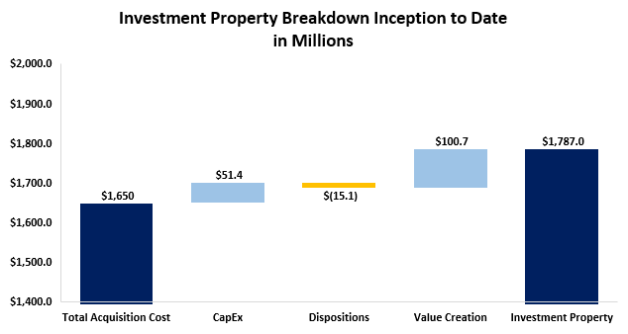
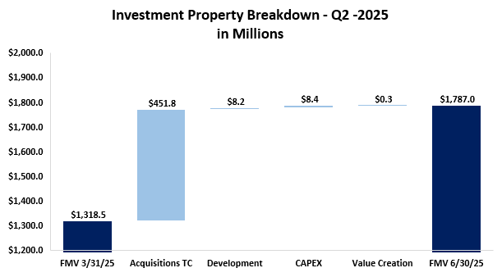
Investment Property Breakdown
Key Takeaways
Key Takeaways
Approximately 48% of the portfolio has been appraised based on the purchase price.
Since Inception, the fund has incurred a total of $18.4M in closing costs related to the acquisition of the properties. These closing costs have partially offset the overall value creation amount over the specified period.
The fund properties' Fair Market Value stands at $1,787M, which is 6% higher than the total cost (including CAPEX), which amounts to $1,688M.
In Q2-25, the Fund acquired 39 properties for a total cost of $452M, invested $8.4M in CAPEX and $8.2M in development projects.
During Q2-25, 24 properties were appraised, for a total appraised value of $261.6M
The Q2-25 value creation of approximately $.3M includes a Q2 unrealized gain from appraisals of approx. $4.1M, largely offset by acquisition closing costs of approximately $3.8M.
Notes:
Spacing on the boxes

Slide 44
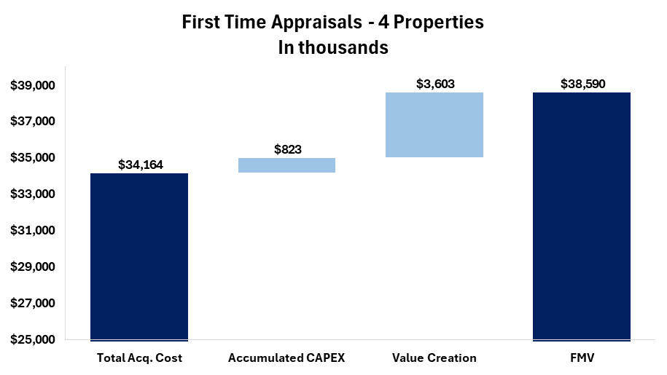
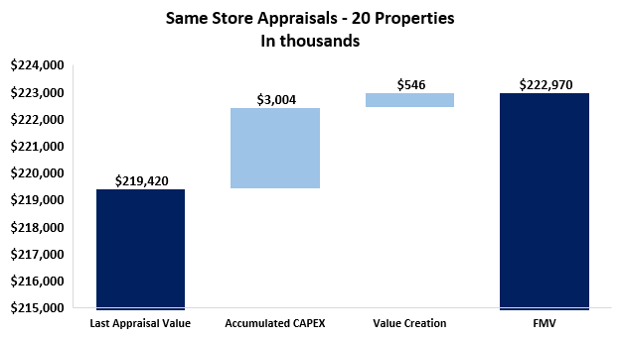
Q2-2025 Appraisals
Key Takeaways
In Q2-25, 24 properties were appraised with a value creation of approximately $0.3M. ($4.1M gain offset by acquisition closing costs $3.8M)
Among these, 4 properties were appraised for the first time, showing a value increase of approximately $3.6M, representing a 10.3% gain over cost and accumulated CAPEX of $0.8M
The remaining 20 properties, which had been appraised before, showed minimal value creation during this batch, value creation in comparison to purchase price and accumulated CAPEX is 13.8%

Slide 45
OPEN FOR REVIEW –
Fund Finance
Market Analysis
Notes:
Focus on – Market # of properties , TC included capex – FMV – Appreciation – General , high level , open AR , - NOI , YOC – Occupancy / sqft – NOI / sqf – base rent / sqft

Slide 46


Actual v Budget⁽¹⁾ Analysis
Key Takeaways
The decrease in NOI is due to higher recoverable operating expenses, partially offset by other income from late fees.
Operating Expenses– There was an increase in snow removal, security control and fire protection services, these are all unbudgeted recoverable expenses.
Property G&A Expense- Increased due to unbudgeted consulting fees for environmental remediation and legal fees
Other income – The major driver is receiving the termination fee in Q1-25 which was budgeted in the current period.
1
2
3
1
2
3
$1,636M
Total Cost
176 Buildings
Above figures exclude any disposed properties.
* Budget column represents 2025 property-level budgets, includes all properties owned by the Fund as of end Q1-2025
Notes:
93.2% physical occupancy –take language from Fund 2 89.6%
from recoverable repairs and maintenance and utilities

Slide 47
Same Store⁽¹⁾ Analysis
Key Takeaways
1
The decrease in NOI is due less additional rent from late fees and higher recoverable operating expenses
Base Rent – The increase mainly from one month of rent being recognized in the prior quarter from a newly signed significant lease.
Property G&A Expense- Increased due to environmental remediation and legal fees as discussed on the previous slide.
Other income – The major driver is receiving the termination fee in Q1-25.
1
2
3
2
3
$1,076M
Total Cost
125 Buildings
Above figures exclude any disposed properties.
Notes:
1125 hendricks

Slide 48
OPEN FOR REVIEW –
Fund Finance
Market Analysis
Notes:
Focus on – Market # of properties , TC included capex – FMV – Appreciation – General , high level , open AR , - NOI , YOC – Occupancy / sqft – NOI / sqf – base rent / sqft

Slide 49
Properties Performance
Key Takeaways
Q2 2024: Slight decrease to YOC in Q2 2024 due to an increase in the operating expenses, mainly insurance and utilities
Q3 – Q4 2024: YOC decrease in H2-24 mainly due to an increase in operating expenses, mainly due to duplicate insurance expenses. In H2-24, the Fund acquired 41 properties with an in-place acquisition YOC of 5.5%.
Q1 2025: YOC slight increased in Q1-25 due to increase in same store NOI as explained in the previous slide.
Q2 2025: YoC decrease of 15 bps was attributed to performance from assets acquired in 2025, specifically vacant properties from Q1 acquisitions.
Physical Occupancy
89.5%
89.2%
89.6%
93.2%
*the WATC is excluding development projects.
** 2024 YoC% was adjusted to reflected the fair share of the Cam Reconciliation for that period.

Slide 50
Fund Performance |Non-GAAP KPIs
Key Takeaways
The FFO for Q2 2025 is $1.9M, which represents 1.2% of the $616M of WA Equity
FFO increased due to newly entered hedge income as well as increase in assets from PQ.
Core FFO is increased by the effect of the management fees that are being paid based on commitments ($916M) even though the WA Equity is only $616M.
In addition, $134.5M weighted avg subline balance at 6.3% interest rate drives down FFO while boosting IRR
Core FFO for the quarter is $2.8M, which represents 1.8% of the $616M WA equity
Excluding $0.9M of commitment fees and add back only mgmt. fees on $616M WA equity.
The theoretical Core FFO is $3.9M which represents 2.9% of the Theoretical Equity of $534M (assuming 60% LTC).
Theoretical G&A Adj: Applies G&A of 0.5% against only the $534M theoretical equity.
Theoretical Management Fees Adj: Mgmt. fee % applied only against the $534M theoretical equity
Theoretical Interest Expenses Adj: This applies interest rate to 60% LTC debt balance which decreases core FFO as we operate in less than 60% LTC
Notes:
Expected Core FFO with the current yield on cost and interest environment under the assumption of full deployment and add timeline of initial clsing deployment period

Slide 51
Fund Performance | Non-GAAP KPIs
Key Takeaways
Core AFFO is ($4.8M) which represents (3.1%) of the of the $616M WA equity
Including $8.4M CAPEX invested in the quarter
Excluding $704k non-cash financing cost amortization and change in bad debt allowance

Slide 52
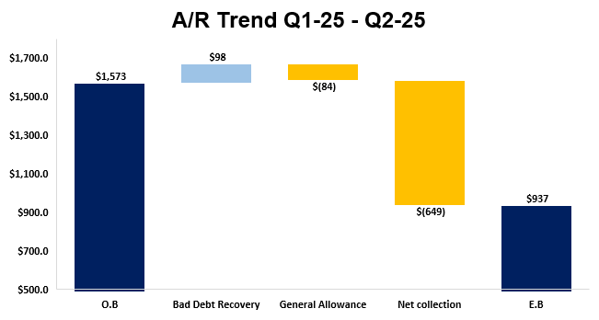
A/R Trend Summary
Key Takeaways
AR balance improved in comparison to PQ mainly due to greater net collections detailed below, bad debt recovery, offset by an increase to general allowance
Bad Debt Recovery:
Composed of collections from previously written off AR mainly from two tenants, noted on the following slide.
Offset mainly by, Sannova Analytical at 155 Pierce where we are filing for eviction and if evicted, we will be reimbursed from escrow.
General Allowance
Calculated in accordance with the General Allowance methodology, increase in line with the overall increase in AR of 90 days balance QoQ. Mainly drive by PY CAM reconciliations.
Net Collections
In the CQ, collections were greater than new tenant billings.
As part of the technical billing cycle in Q2’25, $255k was recorded as revenue but later reversed as part of a Specific Bad Debt Allowance provision, after it was determined that collection was not probable.
1
2
3
1
2
3
Notes:
Bad Debt Recovery:
Composed of collections from previously written off AR mainly from the following two tenants:
Xcision Medical at 9176 Red Branch – made payments since PQ
BES Associates at 12900 NW 38th Ave – made payments on written off late fees
General Allowance
Calculated in accordance with the General Allowance methodology, slight increase in line with the overall increase in AR balance QoQ
Net Collections
In the CQ, collections were greater than new tenant billings.
As part of the technical billing cycle in Q1’25, $190K was recorded as revenue but later reversed as part of a Specific Bad Debt Allowance provision, after it was determined that collection was not probable.

Slide 53
Financing Metrics | Cash Basis vs Effective Interest Rate by Loan
Key Takeaways
The base interest of the fund is 5.7% after taking a weighted average across all loans (including the subline and dev) and applying hedging
When also factoring in financing costs amortization & unused fees, the effective interest rate is 6.34%
As of quarter end, the fund was 88% hedged (91% excluding the subline and development).
In anticipation of our refi during Q3-25, the fund has entered 4 additional hedges with mandatory hedge termination in Q3-25. The fund is monitoring the markets for the best future hedging strategy available.
The weighted average LTC in Q2-25 is 45% (excluding subline). The weighted average leverage including subline and development loan was 56%
Below LTC on developments is based on full capacity of the loan and full development budget.
LTC
50%**
58%
61%
63%
64%
*The Cap and SWAP hedging effect is associated with the credit Facility.
**LTC Based on the total availability of the credit facility

Slide 54
Main Debt Covenants Overview
*Meets the aggregate collateral pool occupancy test for Credit Facility.
Notes:
Occupancy threshold

Slide 55

Development Deals | Project Analysis
*Term sheet signed
**Asset is wholly owned – budgeted IRR is Gross IRR.
Key Takeaways
Park 295 and Swisher loans both secured with relationship banks in those markets (Pinnacle & Synovus) who were able to offer sub 300s spreads at >60% LTC
Joyce Kilmer loan also secured with a relationship bank (BHI) with higher rate (375bps spread) offset by higher 65% leverage
Lack of bank bids on Gibbstown due to location and small size of project forced debt fund loan with Berkeley at high spread (>500bps)
UW- The original IC memo presented at the investment committee at time of deal.
Forecast – The updated calculation from the forecasted underwriting mode.
Notes:
IC underwriting – most recent forecast -

Slide 56
Development Deals| Project Analysis
**
**
*Term sheet signed
**Budgeted Development Costs- The budgeted costs are based on the most up to date forecasted model. Excluding the total land cost.

Slide 57
Need to be updated
Development Deals | Project Analysis
*Term sheet signed
**Asset is wholly owned – budgeted IRR is Gross IRR.
Key Takeaways
Financing – Park 295 and Swisher loans both secured with relationship banks in those markets who were able to offer. Joyce Kilmer loan also secured with a relationship bank with higher rate but offset by higher leverage. Lack of bank bids on Gibbstown forced debt fund loan with Berkeley at high spread
Park 295 – Pinnacle Bank construction loan officially closed Q2-25, driving higher projected returns due to significantly lower rate than UW (plus slightly higher leverage)
Joyce Kilmer – BHI construction loan closed Q2-25. The project is under construction.
Gibbstown – The project is in pre-construction phase; the project has experienced a 4-month delay which is consistent with a lower IRR.
Swisher – The project is in pre-construction and experienced a 2-month delay. However, the net IRR increased because of lower expected costs.
UW- The original IC memo presented at the investment committee at time of deal.
Forecast – The updated calculation from the forecasted underwriting mode.
Notes:
IC underwriting – most recent forecast -

Slide 58
CAPEX, Tenants Improvements & Leasing Commissions
Key Takeaways
In Q2-25, We recorded CAPEX totaling $8.4M representing 47% of the Funds NOI.
Main investments:
Approximately $2.1M of the quarters CAPEX was allocated to roof replacements across 5 properties.
There were 3 draws made from the TI allowance for 1501 Kings Rd for approximately $1.2M.
A TI fit out was completed at 3 Pearl Ct for approximately $750K
Inception to Date Capex:
The Fund has invested $38.3m in capex, 33.4% of cumulative NOI.
26 properties have had roof replacements for approx. $12.4M.
Comparison to ITD Budget
The fund came in under budget mainly due to timing differences, the work is still planned and will roll into future periods.
*Turnover Costs represent the estimated obligations incurred in connection with the signing of a lease; including leasing commissions and tenant improvements
Notes:
Roof HVAC , etc.

Slide 59
Sources & Uses| After Refi
Need to Revised to reflect the dry powder
Source |  | As of Today - Mapletree | After Refi
Total Cost⁽¹⁾ |  | $1,650M | $1,662M
Development Deployment |  | $0M | $4M
Other Uses & Cash |  | $64M | $64M
Total Uses |  | $1,714M | $1,730M
Total Equity Called |  | $872M | $872M
Fixed Refi’s | Apollo | $94.5M | $94.5M
 | NYL | $90M | $90M
 | Blackstone | $81.5M | $81.5M
 | Subtotal | $266M | $266M
Credit Facility | Term Loan | $175M | $175M
 | Revolver Outstanding | $338M | $44M
 | Bridge Loan | $40M | $0M
 | Subtotal | $553M | $219M
New Refi |  | $0M | $350M
Subline |  | $23M | $23M
Total Debt |  | $841M | $858M
Total Sources |  | $1,714M | $1,730M
Key Takeaways
Key Takeaways
The fund plans to close on one additional asset which was included in the original pipeline to close prior to MapleTree.
After the acquisition of Maple Tree, the Fund will pause future acquisitions until Maple Tree is stabilized, due to potential FCCR Limitations.
Subject to FFCR Limitation amendment and Future NOI Growth, the fund will have additional dry powder of ~25M-75M (we plan to approach key bank upon finalization of Fund 4 Facilities)
Debt balances exclude construction loans, as these do not impact the fund’s sources and uses—capital expenditures will be fully covered by construction loan proceeds.
Notes:
Visualize the new challenges, new dry powder.

Slide 60
NWBC JV, LP Co-Investment with Morgan Stanley

Slide 61
Profit & Loss
Key Takeaways
NOI is consistent to PQ with a slight decrease related to the below:
Repairs performed in Q2-25 related to the masonry, recoverable asphalt and paving led to the increase noted in operating expenses in comparison to Q1-25.
1
1
Notes:
While total income had a notable increase total operating expenses have increased as well.

Slide 62
Fund Performance | Non-GAAP KPIs
Key Takeaways
The FFO in Q2-25 is $0.6M, which represent 3.8% of the $59M Equity.
FFO decrease due to slight decrease in NOI due to higher R&M than PQ
The Core FFO for the period is $0.6M, which represents 3.8% of the equity.
Core FFO decreased due to higher R&M as well
The AFFO for the period is ($0.6M), which represents (4.3%) of the equity.
NOI decreases mentioned above as well as additional capex resulted in this decrease in AFFO.

Slide 63
Balance Sheet and S&U
Key Takeaways
Fund continued ongoing construction projects which contribute to the higher operating portfolio amount.
Fund is considering a future distribution once the is more certainty around future capex.
Increase in liabilities relates to a tenant improvement liability
Notes:
What property is 1.5M related to?

Slide 64
Fund Forecast

Slide 65
Fund Performance Forecast | Acquisitions Pace
Key Takeaways
There will be ~$293M of available remaining deployment if the Fund relied solely on Future NOI Growth and the Truist Refi
There will be ~$600M of available remaining deployment if the Fund goes forward with the Co-Invest and Plymouth Sale
Both Scenarios assume a recast of our current facility to extend the term through the fund life
Future NOI Growth of the Fund allows $192M additional acquisitions
Total land, future construction costs, and development JV buyouts of $89M
Truist Refi results in $101M additional acquisitions
Total Acquisitions as of Q3 2025(excl. land) of $1,538M factoring in 51% co-invest with MS
MapleTree Co-Invest results in $210M additional acquisitions
Plymouth Sale results in $90M additional acquisitions
Notes:
Left graph should be % accumulated equity Deployed (less Equity reserves) and % accumulated Deployment
Right graph is cluster bar graph with $ Deployment and equity

Slide 66
Fund Performance Forecast | Dispositions
Key Takeaways
There have been 3 dispositions in the fund to date, with a total sales price of ~$15.8M
The model assumes 10 future dispositions totaling ~$111.6M of sales price before the sale of the fund, largely misfits and other select assets with quality or location issues
In the scenario where we sell to Plymouth, we model a sale occurring 10/1/2025 at a $100.9M sales price
Asset Name | Area (SF) | Sales Price | Disposition Date
5425 & 5445 E Raines | 169.3k | $6.8M | 12/26/2024
631 S Royal Lane | 51.4K | $9.0M | 1/30/2025
4000-4024 Precision Dr | 235.9k | $12.0M | 8/15/2025
1460 N Glenville Drive | 121.1k | $27.0M | 8/15/2025
9176 Red Branch | 81.3k | $10.8M | 9/1/2025
1120 Vend Drive | 25.0K | $2.4M | 9/30/2025
Plymouth Portfolio | 1.9M | $100.9M | 10/1/2025
321 Richard Mine Road | 80.0K | $12.9M | 1/1/2026
645-651 NW Enterprise Dr | 48.8K | $6.8M | 1/1/2026
569 Joyce Kilmer Ave | 25.4K | $5.1M | 4/1/2026
9 S. Forrest Avenue | 49.9K | $6.1M | 4/1/2027
410 Factory | 41.6K | $3.9M | 4/1/2027
1425 Grandview Avenue | 47.3K | $8.9M | 4/1/2027
Total | 976.9K SF | $111.6M
w/ Plymouth | 2.9M SF | $212.6M
Assets realized as of 6/30/25
Dispositions
Q4 2024 | $6.8M | 169.3k SF
Q1 2025 | $9.0M | 51.4K SF
Q3 2025 | $52.3M | 24.8K SF
Q4 2025 | $100.9M | 97.4K SF
Q1 2026 | $19.6M | 128.8K SF
Q2 2026 | $5.1M | 25.4K SF
Q2 2027 | $18.9M | 169.7k SF
Total | $111.6M | 635.8K SF
w/ Plymouth | $212.6M | 2.9M SF
Plymouth Dispo 10/1/2025

Slide 67
Fund Performance Forecast | Yield on Cost
Key Takeaways
In 2025, the fund’s projected YOC is due to low YOC of Mapletree and the other pipeline assets
In 2026-2028 moving MapleTree to a Co-Invest and going forward with the Plymouth Sale gives only a 1 to 2 bps boost to YoC
Notes:
Left graph is clustered bar from Q4 FPR with and without Development deals
Right Graph is clustered bar from Pipeline model with and without development

Slide 68
Fund Performance Forecast | CapEx, TI & LC w/ MT Co-Invest & Plymouth Sale
Key Takeaways
CapEx PSF is ticks down in 2026, while TIs are highest in 2027-28 due to lease expirations in 2026-27
For future acquisitions, we assume constant TIs ($ PSF) and LCs (% of NOI) each year, creating less variability in their forecasts
Notes:
Pipeline Model

Slide 69
Financing Strategy & Summary
Simplified version
Key Takeaways
The Fund is expected to close on an $350M loan with Truist & US Bank for a pool of 46 properties in August 2025
Capital Call Line was paid down from $150M to $25M, we expect to terminate it in Q4 2025
Credit Facility increased from $247.5M to $553M, $75M of additional commitments secured to fund Mapletree Acquisition
 | Credit Facility | Term Loans
Lender
Interest Rate | SOFR | 4.10% | 4.00% | 4.63% | SOFR
Spread | 1.80%-1.85% | 2.05% | 2.30% | 1.90% | 1.90%
All-In Rate | N/A | 6.15% | 6.30% | 6.53% | SOFR + 1.90%
Effective Amount Hedged | $182M | $94.5M (100%) | $90M (100%) | $81.5M (100%) | $350M (100%)
Hedged All in Interest Rate | 5.61% | 6.15% | 6.30% | 6.53% | 5.50%
Loan Commitments | $605M | $94.5M | $90M | $81.5M | $350M
Effective Used Debt | $553M | $94.5M | $90M | $81.5M | $350M

Slide 70
Loan & Hedging Maturities
We are here – July ‘25
 | Instrument | Committed | Rate |  | May 22’ |  | May 23’ |  | May 24’ |  | May 25’ |  | May 26’ |  | May 27’ |  | May 28’ |  | May 29’ |  | May 30’
Hedging | Cap | $20M | 3.30% + 1.80% = 5.10%
 | Cap | $51M | 3.00% + 1.80% = 4.80%
 | Cap | $40M | 3.00% + 1.80% = 4.80%
 | Swap | $50M | 2.54% + 1.80% = 4.34%
 | Swap | $21M | 4.08% + 1.80% = 5.88%
 | Swap (Truist) | $350M | Rate TBD
Credit Facility | Revolver | $355M | Avg. of ~180 bps spread
 | Term Loan | $175M
Term Loans | Apollo | $94.5M | 4.10% + 2.05% = 6.15%
 | NYL | $90M | 4.00% + 2.30% = 6.30%
 | BX | $81.5M | 4.63% + 1.90% = 6.53%
 | Truist (Closing) | $350M | SOFR + 1.90%
Aug ‘22
Aug ‘25
Nov ‘22
Nov ‘26
Dec ‘22
Dec ‘29
Aug ‘22
Jun ‘27
Nov ‘22
Jun ‘27
Aug ‘25
Aug ‘29
May ‘22
Jun ‘27
May ‘22
Jun ‘27
Oct ‘23
Oct ‘28
Feb ‘24
Feb ‘29
Sep ‘24
Sep ‘29
Aug ‘25
Aug ‘30
Only 51% ($46M) remains in Fund III, with the rest being tied to co-invest with Morgan Stanley

Slide 71
Fund Performance Forecast | Hedging & Debt Forecast w/ MT Co-Invest & Plymouth Sale
Key Takeaways
Currently, the Fund has $182M of hedging against the credit facility at a 3.03% weighted average SOFR rate with staggered maturity dates from 3Q25 to 1Q29
The Apollo, New York Life, and Blackstone refinances are fixed rate loans, providing additional hedging through the remainder of the fund term
The model uses the all-in rate for the $350M Truist loan of SOFR +190 bps with a hedged rate of 5.50%
Note: SOFR forward curve as of July 23rd, 2025
Notes:
Pipeline Model

Slide 72
Fund Performance Forecast | Quarterly FFO Forecast
Key Takeaways
Core FFO and AFFO are similar but improve slightly after the MT co-invest and Plymouth sale
The boost to AFFO after the co-invest and sale is driven by avoiding high CapEx, TI & LCs for the MT portfolio
Per this forecast, the fund can support 4% Core FFO distributions in 2026 and 5-6% in 2027
Notes:
Left graph is from Q4 FPR model
Right graph is from Pipeline Model

Slide 73
Fund Performance Forecast | Annual FFO Forecast
Key Takeaways
Core FFO and AFFO are similar but improve slightly after the MT co-invest and Plymouth sale
The boost to AFFO after the co-invest and sale is driven by avoiding high CapEx, TI & LCs for the MT portfolio
Per this forecast, the fund can support 4% Core FFO distributions in 2026 and 5-6% in 2027
Notes:
Left graph is from Q4 FPR model
Right graph is from Pipeline Model

Slide 74
Fund Performance Forecast | Performance Overview
Key Takeaways
In the Base Case, the Fund reaches 17.28% Gross IRR & 13.54% Net IRR
When the Co-Invest and Plymouth sale are modeled, the Fund reaches 17.39% Gross IRR & 13.64% Net IRR
The Base Case and Co-Invest & Plymouth Dispo Model use exit caps of 5.84% and 5.85% respectively, modeled over a 7-year hold period (assuming a sale on January 1st, 2029)
Base Case Model Jan 1st, 2029 Sale
With Co-Invest & Plym Dispo Model Jan 1st, 2029 Sale
Notes:
Left Sensitivity table will be including previously used Exit Cap and the new methodology exit cap in the table with EMs, Sale Prices, GP Promote from Q4 FPR Model
Right Sensitivity table will be including previously used Exit Cap and the new methodology exit cap in the table with EMs, Sale Prices, GP Promote from Pipeline Model

Slide 75
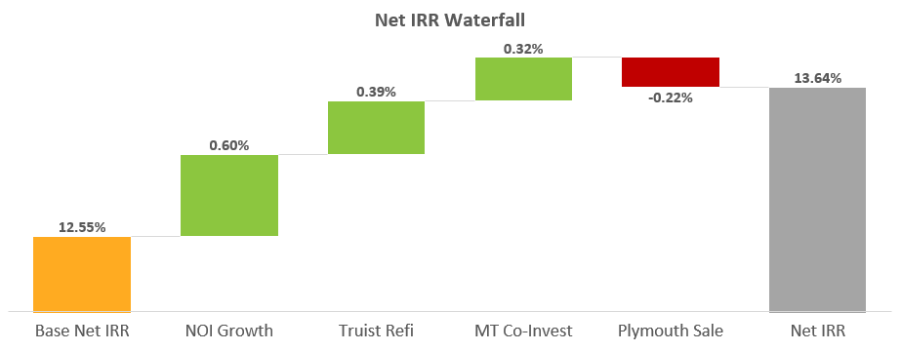
Fund Performance Forecast | IRR Waterfall
Key Takeaways
The Base Net IRR represents the return of the fund if none of the additional $500-600M of future acquisitions are completed
The NOI growth boosts represents the impact from the $190M of additional acquisitions from Q1 2026 through Q2 2027
The Truist refi represents the impact of the $100M additional acquisitions supported by surplus availability created through refi
The Plymouth sale decreases the IRR since Memphis assets are currently UW at a low-to-mid 6% exit cap rate in the model but are being sold at cost today
IRR will be reduced by ~20bps if deployment pace of future acquisitions is limited to ~$80M per quarter

Slide 76
Fund Performance Forecast | DSCR Forecast
Key Takeaways
The DSCR Stress case layers on a 50 bps increase to the 10Y Treasury starting 8/1/2025 and an additional 2% NOI Reduction
In the Base Case the DSCR bottoms out at 1.46x in 2027, when stressed it gets to a 1.36x
With the MapleTree and Plymouth Disposition the DSCR bottoms out at 1.50x in 2027, when stressed it gets to a 1.37x
Temporary boost due to additional proceeds from Truist refi before more acquisitions are made
Note: 10Y Treasury forward curve of 4.36% as of 7/23/25

Slide 77
Fund Performance Forecast | FCCR Forecast
Key Takeaways
In the Base Case with $293M of future acquisitions, the FCCR stays above the 1.50x FCCR buffer getting to 1.82x in Q2 2027
When including the MapleTree Co-Invest, Plymouth Sale and $593M of future acquisitions, the FCCR stays above the 1.50x FCCR buffer as well getting to 1.80x in Q2 2027

Slide 78
Fund Performance Overview | Seed Portfolio Forecast
OPEN –
Corp Finance
Key Takeaways
The assets in the seed portfolio reach 16.8% Gross & 12.6% Net IRR over a 6-year hold period (sale on Jan 1, 2028) and assuming a 5.75% exit cap
Although we plan to sell the fund after 7 years, we evaluate the seed portfolio assets over a 6-year hold since this is roughly the average hold time of all projected fund assets (since assets purchased in 2024-25 will be held for under 6 years)
Core FFO is slightly higher for the seed portfolio than full fund since these assets are purchased earlier
 | End of 2027 | End of 2028
Hold Period Scenarios | 6 Years | 7 Years
Gross IRR | 16.8% | 15.9%
Net IRR | 12.6% | 12.2%
Gross Equity Multiple | 1.75x | 1.93
Net Equity Multiple | 1.57x | 1.72
GP Promote | $48.3 | $60.7
Disposition Cap Rate | Gross IRR 16.8% | Net IRR 12.6%
5.25% | 21.1% | 16.5%
5.50% | 18.9% | 14.5%
5.75% | 16.8% | 12.6%
6.00% | 14.7% | 10.9%
6.25% | 12.7% | 9.6%

Slide 79
Appendices

Slide 80
A/R Specific Allowance - Deep Dive
Notes:
appendix

Slide 81
NYL Pool (NNJ Co-Invest)

Slide 82
Yield on Cost & CapEx Forecast | NYL
Key Takeaways
Yield on Cost for our NYL pool grows most sharply in 2028 as many properties unlock during 2027
CapEx and TI/LC stays flat over time, stabilizing near $2M annually
Accumulated CapEx and TI/LC reach $10.6M for the NYL pool by the end of 2028

Slide 83
Debt Yield Covenant Analysis| NYL
Key Takeaways
Debt Yield covenant remains flat at 8.5% (equating to an annualized NOI of $7.65M) throughout the course of the loan
Stryker lease expiration at the end of 2026 results in significant drop to quarterly NOI in Q1 2027 (amplified since the adjusted NOI is calculated by annualizing the quarterly NOI)
Debt Yield Covenant uses the quarters NOI annualized for calculation

Slide 84
Fund Performance Overview | NNJ Co-Invest
Key Takeaways
The co-invest with Morgan Stanley is projected to reach 19.1% Gross & 16.7% Net IRR, assuming sale on Jan 1, 2029 (aligned with full fund), 5.50% disposition cap rate, 1.25% management fee, and 10% GP promote
Distributions CoC% differs from AFFO % since in certain quarters the co-invest will prepare for large upcoming capex events by keeping additional reserves

Slide 85
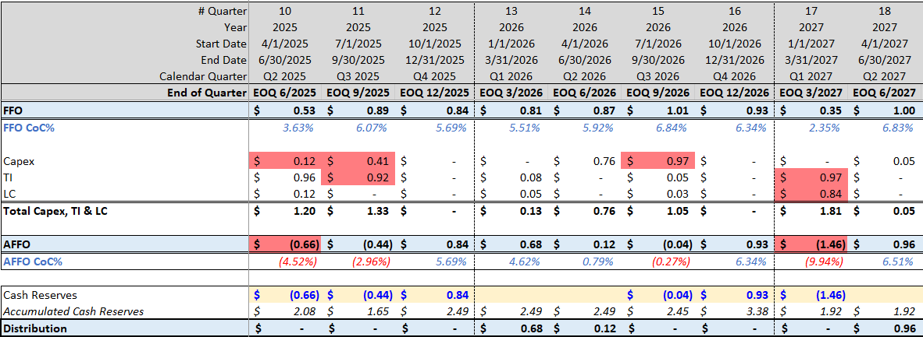
Reserves Policy | Next 30 Months Cashflow Forecast
Key Takeaways
In the next 30 months, we have significant capex events in 2025 through 2027
We will need to set aside reserves in 2026 to cover the negative Q1-27 AFFO
Step 1: Notice upcoming negative AFFO period or large CapEx Events
Step 2: Build cash reserves balance in advance
Step 3: Draw on reserves balance in required period to enable distribution
1
1
2
3

Slide 86
Yield on Cost & CapEx Forecast | NYL
OLD
Key Takeaways
Yield on Cost for our NYL pool grows most sharply in 2028 as many properties unlock during 2027
CapEx and TI/LC stays flat over time, stabilizing near $2M annually
Accumulated CapEx and TI/LC reach $9.6M for the NYL pool by the end of 2028

Slide 87
Debt Yield Covenant Analysis| NYL
OLD
Key Takeaways
Debt Yield covenant remains flat at 8.5% throughout the course of the loan
Stryker lease expiration at the end of 2026 results in significant drop to quarterly NOI in Q1 2027 (amplified since the adjusted NOI is calculated by annualizing the quarterly NOI)
Debt Yield Covenant uses the quarters NOI annualized for calculation

Slide 88
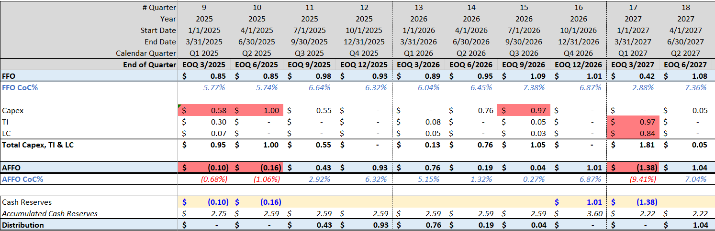
Reserves Policy | Next 30 Months Cashflow Forecast
OLD
Key Takeaways
In the next 30 months, we have significant capex events in 2025 through 2027
We will need to set aside reserves in 2026 to cover the negative Q1-27 AFFO
Step 1: Notice upcoming negative AFFO period or large CapEx Events
Step 2: Build cash reserves balance in advance
Step 3: Draw on reserves balance in required period to enable distribution
1
1
3
2

Slide 89
Fund Performance Overview | NNJ Co-Invest
OLD
Key Takeaways
The co-invest with Morgan Stanley is projected to reach 20.6% Gross & 18.1% Net IRR, assuming sale on Jan 1, 2029 (aligned with full fund), 5.50% disposition cap rate, 1.25% management fee, and 10% GP promote
Distributions CoC% differs from AFFO % since in certain quarters the co-invest will prepare for large upcoming capex events by keeping additional reserves

Slide 90
Definitions

Slide 91
Definitions
Net operating income (NOI): We define NOI as rental income, including reimbursements, less property expenses, which excludes depreciation, amortization, loss on impairments, general and administrative expenses, interest expense, interest income, transaction costs, gain (loss) on involuntary conversion, loss on extinguishment of debt, gain on sales of rental property, Non Recoverable expense and other expenses.
Project Cost: The amount of cash or cash equivalents paid or the fair value of the other consideration given to acquire an asset at the time of its acquisition or construction, or, when applicable, the amount attributed to that asset. (Including Capex (General Building Improvement, Tenant Improvement and Leasing commission)
Yield On Cost: Yield on cost measures income in relation to the total cost of the property YOC% is calculated as a property's Net Operating Income (NOI) divided by the total project cost.
Same Store NOI: We evaluate the performance of the operating properties we own and manage using a “same store” analysis because the population of properties in this analysis is consistent from period to period. We define our same store population for the three months ended Sep 30, 2023 as the properties in our Owned and Managed Operating Portfolio, properties owned by the Fund as at March 31, 2023.

Slide 92
Definitions (continued)
Funds from Operation (FFO): We define FFO in accordance with the standards established by the National Association of Real Estate Investment Trusts (“NAREIT”). FFO represents net income (loss) (computed in accordance with GAAP), excluding gains (or losses) from sales of depreciable operating property, gains (losses) from sales of land, impairment write-downs of depreciable real estate, real estate related depreciation and amortization (excluding amortization of deferred financing costs and fair market value of debt adjustment) and after adjustments for unconsolidated partnerships and joint ventures.
Core FFO: Core FFO excludes transaction costs and non-recurring other expenses.
AFFO: To arrive at AFFO, we adjust Core FFO to include realized gains from the disposition of land and development properties, net of current tax expense, and recurring capital expenditures and exclude the following items that we recognize directly in Core FFO: straight-line rents; (ii) amortization of above- and below-market lease intangibles; (iii) amortization of management contracts; (iv) amortization of debt premiums and discounts and financing costs, net of amounts capitalized, and; (v) stock compensation amortization expense.
Base Interest Rate- The actual Interest that was paid during the period.
Effective Interest Rate (W/O Origination fee amortization)- Base interest Rate plus amortization of hedging costs
Effective Interest Rate- Base interest rate plus hedging costs & origination fee amortization.
Recovery Ratio - Recoveries Incomes/Recoverable and Non-Recoverable Expenses. The KPI will be used to measure our ability to collect recoveries from tenants.

Slide 93
A/R General Allowance - Deep Dive
Fund Finance – updated
Key Takeaways
Key Considerations
General Allowance – Balance of A/R determined based on the A/R Age and % of Allowance, that we estimate will not be collected in the future
A/R General Allowance is recorded at the Fund-level, NOT at the individual Property-level
Financial Metrics Impact
Property Level – No impact in the tenant ledger or A/R Balance of the fund
Fund Level
YOC – No impact
NOI (for bank covenants) – No Impact
FFO – Impact
Core FFO (Distribution Decision) – Impact
Audited P&L - Impact

Slide 94


Financing Cost Summary – Life Company Refi’s
Properties (Number/TC) | 10 / $ 145.3M | 13 / $ 161.5 M | 16/ $ 128M
Term | 5 Years (Mar ‘29) | 5 Years (Oct ’28) | 5 Years (Oct 29’)
Outstanding Loan | $ 90M | $ 94.5M | $81.5M
*Net Proceeds | $ 88.6M | $ 88.4M | $ 78.7 M
Interest Rate | 6.30% | 6.15% | 6.53%
Closing Costs | $ 1.44M | $ 2M | $ 2.1M
Upfront Reserves | - | $4M | $0.7M
Ongoing Reserves Payments Capex/Tax |  | 166K/122K | 26K/114K
LTC | 62% | 59% | 63%
**Effective LTC | 61% | 55% | 61%
***Effective Interest base rate | 6.40% | 6.58% | 6.77%
Closing Cost out of outstanding Loan | 1.6% | 2.13% | 2.61%
Key Takeaways
Higher Closing Costs: Loan closing costs are significantly higher than current model estimates, ranging between 1.6% and 2.61%.
Impact on Effective LTC: The higher closing costs and loan reserves have a significant impact on the effective LTC ratio.
Decreasing LTC Over Time: For these loans, the LTC will decrease over time as no additional draws will be made to finance CapEx
Ongoing Reserves Impact: The ongoing reserves for taxes and CapEx reduce the overall efficiency of the loan. A methodology to capture this impact still needs to be developed.
NYL Loan Efficiency: When factoring in expenses and reserve requirements, the NYL loan emerges as the most efficient option. This may also be related to the quality of the portfolio.
* Net Proceeds- Outstanding Loan minus Closing Costs and Upfront Reserves
**Effective LTC- Net Proceeds divided by TC
***Effective Interest Rate- expected interest expenses divided by Net Proceeds

Slide 95
Ready for review–
Fund Finance
Development Deals| Underwriting Comparison
1
2
Key Takeaways
No significant changes in Hazel Park UW, Swedesboro is still in entitlement stage therefore too early to determine if any significant UW changes will materialize.
Joyce Kilmer -
Total contributions have decreased due to an increase in the expected construction debt loan. We will receive proceeds once the loan is finalized.
Lincoln Swisher –
Total underwritten contributions have decreased because of the increased expected construction debt loan. Most contributions are upcoming, and actual contributions align with the revised underwriting.
1
2

